Slide 1
Control flow in MIPS
CSE-3109 Computer Architecture
Lecture 7

Slide 2
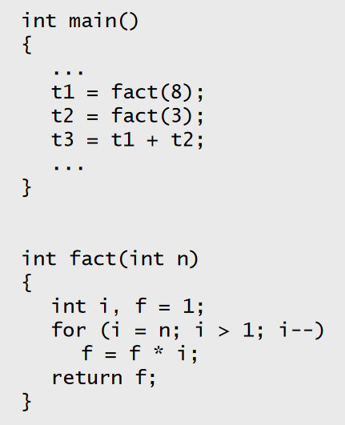
Control flow in C
Invoking a function changes the
control flow of a program twice.
  Calling the function
  Returning from the function
In this example the main function calls fact twice, and fact returns twice—but to different locations in main.
Each time fact is called, the CPU has to remember the appropriate return address.
Notice that main itself is also a function! It is called by the operating system when you run the program.

Slide 3
Function control flow MIP
MIPS uses the jump-and-link instruction jal to call functions.
The jal saves the return address (the address of the next instruction) in the dedicated register $ra, before jumping to the function.
jal is the only MIPS instruction that can access the value of the program counter, so it can store the return address PC in $ra.
jal Fact
$ra will be implicitly overwritten by the jal instructions.

Slide 4
Function control flow MIP
To transfer control back to the caller, the function just has to jump to the address that was stored in $ra.
jr $ra
The jump-and-link-register instruction ( jalr ) is the union of JAL and JR , meaning that it transfers control to the address in a specified register, and stores the return address in the register file.

Slide 5
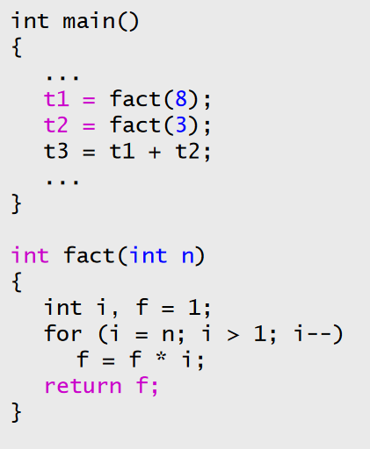
Data flow in C
Functions accept arguments and produce return values.
The blue parts of the program show the actual and formal arguments of the fact function.
The purple parts of the code deal with returning and using a result.

Slide 6
Data flow in MIPS
MIPS uses the following conventions for function arguments and results.
Up to four function arguments can be “passed” by placing them in argument registers $a0-$a3 before calling the function with jal.
A function can “return” up to two values by placing them in registers $v0-$v1, before returning via jr.
These conventions are not enforced by the hardware or assembler, but programmers agree to them so functions written by different people can interface with each other.

Slide 7
The big problem so far
There is a big problem here!
— The main code uses $t1 to store the result of fact(8).
— But $t1 may be also used within the fact function!
The subsequent call to fact(3) may overwrite the value of fact(8) that was stored in $t1

Slide 8
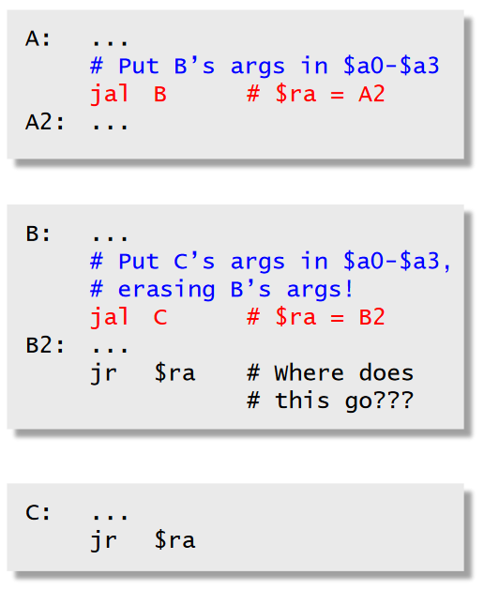
Nested functions
A similar situation happens when you call a function that then calls another function.
Let’s say A calls B, which calls C:
  The arguments for the call to C would be placed in $a0-$a3, thus overwriting the original arguments for B.
  Similarly, jal C overwrites the return address that was saved in $ra by the earlier jal B.

Slide 9
Spilling
The CPU has a limited number of registers for use by all functions, and it’s possible that several functions will need the same registers.
We can keep important registers from being overwritten by a function call, by saving them before the function executes, and restoring them after the function completes.
But there are two important questions.
  Who is responsible for saving registers—the caller or the callee?
  Where exactly are the register contents saved?

Slide 10
Who saves the registers?
Who is responsible for saving important registers across function calls?
  The caller knows which registers are important to it and should be saved.
  The callee knows exactly which registers it will use and potentially overwrite.
However, in the typical “black box” programming approach, the caller and callee do not know anything about each other’s implementation.
  Different functions may be written by different people or companies.

Slide 11
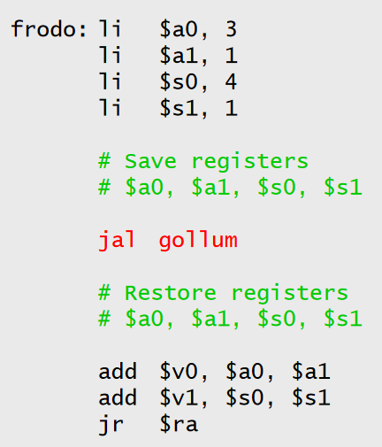
The caller could save the registers...
One possibility is for the caller to save any important registers that it needs before making a function call, and to restore them after.
But the caller does not know what registers are actually written by the function, so it may save more registers than necessary.
In the example on the right, Frodo wants to preserve $a0, $a1, $s0 and $s1 from gollum, but Gollum may not even use those registers.

Slide 12
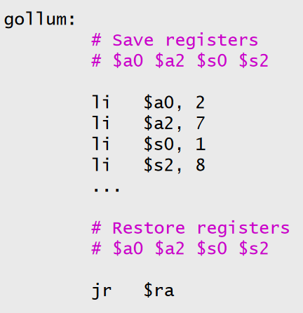
...or the callee could save the registers...
Another possibility is if the callee saves and restores any registers it might overwrite.
For instance, a gollum function that uses registers $a0, $a2, $s0 and $s2 could save the original values first, and restore them before returning.
But the callee does not know wha registers are important to the caller, so again it may save more registers than necessary

Slide 13
...or they could work together
MIPS uses conventions again to split the register to relieve the responsibilities.
The caller is responsible for saving and restoring any of the following caller-saved registers that it cares about.
In other words, the callee may freely modify these registers, under the assumption that the caller already saved them if necessary.

Slide 14


The callee is responsible for saving and restoring any of the following callee-saved registers that it uses. (Remember that $ra is “used” by jal.)
  $ra is tricky; it is saved by a callee who is also a caller
Be especially careful when writing nested functions, which act as both a caller and a callee!

Slide 15
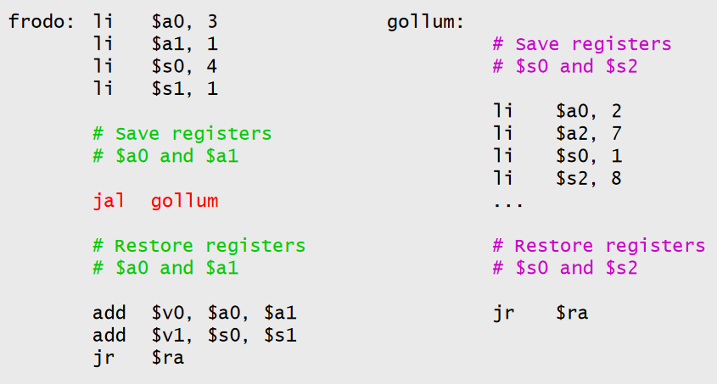
Register spilling example
This convention ensures that the caller and callee together save all of the important registers—frodo only needs to save registers $a0 and $a1, while gollum only has to save registers $s0 and $s2.
Correction: in Gollum $a2 will be $a1

Slide 16
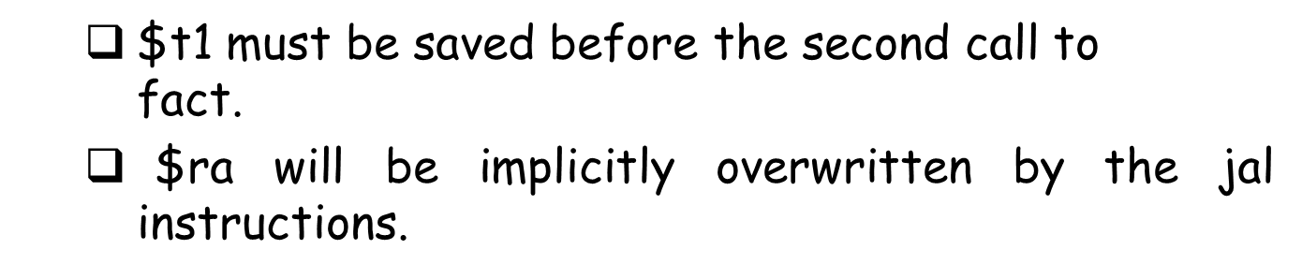
How to fix factorial
In the factorial example, main (the caller) should save two registers.
But fact (the callee) does not need to save anything. It only writes to registers $t0, $t1 and $v0, which should have been saved by the caller.

Slide 17
End

